Slide 1
Project 'Novel Contribution', 'Work by Competitors', 'Data', and 'Method'
By Vivek Pandiyan

Slide 2
Novel Contribution

Slide 3
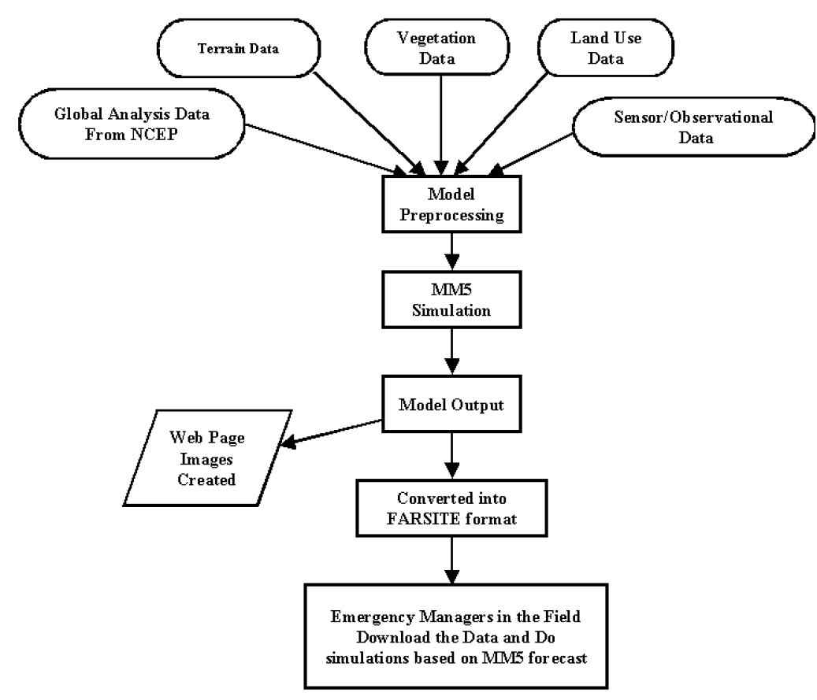
Flow Chart

Slide 4
Work by Competitors

Slide 5
Data

Slide 6
Method
Linear Regression -

Slide 7
Linear Regression
Simple straight relapse is a measurable method that permits us to summarize and examine connections between two persistent (quantitative) factors.
Simple straight relapse is a factual method that permits us to summarize and ponder connections between two consistent (quantitative) factors:
One variable, denoted x, is viewed as the indicator, illustrative, or free factor.
The other variable, denoted y, is viewed as the reaction, outcome, or ward variable.
Since alternate terms are utilized less every now and again today, we'll utilize the "indicator" and "reaction" terms to allude to the factors experienced in this course. Alternate terms are mentioned just to make you mindful of them should you experience them in different fields. Simple direct relapse gets its descriptor "simple," since it concerns the investigation of just a single indicator variable. Interestingly, multiple direct relapse, which we concentrate later in this course, gets its descriptor "multiple," on the grounds that it concerns the investigation of two or more indicator factors.

Slide 8
Support Vector Machine(SVM)
Bolster Vector Machine" (SVM) is an administered machine learning algorithm which can be utilized for both characterization or relapse challenges. we plot every information item as a point in n-dimensional space (where n is number of components you have) with the estimation of each element being the estimation of a specific organize.
Pros:
It works truly well with clear margin of division
It is powerful in high dimensional spaces.
It is powerful in situations where number of dimensions is more prominent than the number of samples.
It utilizes a subset of preparing focuses in the choice capacity (called bolster vectors), so it is likewise memory productive.
Cons:
It doesn't perform well, when we have substantial informational collection in light of the fact that the required preparing time is higher

Slide 9
Random Forest
Random forests or random decision forests are an ensemble learning method for classification, regression and other tasks, that operate by constructing a multitude of decision trees at training time and outputting the class that is the mode of the classes (classification) or mean prediction (regression) of the individual trees. Random decision forests correct for decision trees' habit of overfitting to their training set.
The first algorithm for random decision forests was created by Tin Kam Ho using the random subspace method
Components of Random Forests
It is unexcelled in precision among current algorithms.
It runs productively on huge information bases.
It can deal with a large number of information factors without variable cancellation.
It gives estimates of what factors are important in the order.

Slide 10
References
Spencer, Matthew, et al. "Executing multiple pipelined data analysis operations in the grid." Proceedings of the 2002 ACM/IEEE conference on Supercomputing. IEEE Computer Society Press, 2002.
Kim, Hwi-Gang, Seongjoo Lee, and Sunghyon Kyeong. "Discovering hot topics using Twitter streaming data social topic detection and geographic clustering." Advances in Social Networks Analysis and Mining (ASONAM), 2013 IEEE/ACM International Conference on. IEEE, 2013.
Buneci, Emma S., and Daniel A. Reed. "Analysis of application heartbeats: Learning structural and temporal features in time series data for identification of performance problems." Proceedings of the 2008 ACM/IEEE conference on Supercomputing. IEEE Press, 2008.
Wolski, Rich, Neil Spring, and Chris Peterson. "Implementing a performance forecasting system for metacomputing the network weather service." Supercomputing, ACM/IEEE 1997 Conference. IEEE, 1997.
Roe, Kevin, Duane Stevens, and Carol McCord. "High resolution weather modeling for improved fire management." Proceedings of the 2001 ACM/IEEE Conference on Supercomputing. ACM, 2001.
James Stephen, Julian, et al. "Program analysis for secure big data processing." Proceedings of the 29th ACM/IEEE international conference on Automated software engineering. ACM, 2014.
Swany, Martin, and Rich Wolski. "Multivariate resource performance forecasting in the network weather service." Supercomputing, ACM/IEEE 2002 Conference. IEEE, 2002.
Primet, Pascale, Robert Harakaly, and Franck Bonnassieux. "Experiments of network throughput measurement and forecasting using the network weather." Cluster Computing and the Grid, 2002. 2nd IEEE/ACM International Symposium on. IEEE, 2002.
Cheng, Shanjun, Anita Raja, and Victor Lesser. "Multiagent meta-level control for a network of weather radars." Web Intelligence and Intelligent Agent Technology (WI-IAT), 2010 IEEE/WIC/ACM International Conference on. Vol. 2. IEEE, 2010.
Roe, Kevin, Duane Stevens, and Carol McCord. "High resolution weather modeling for improved fire management." Proceedings of the 2001 ACM/IEEE Conference on Supercomputing. ACM, 2001.

